Slide 1
360 degree Conferencing Webcam

Slide 2
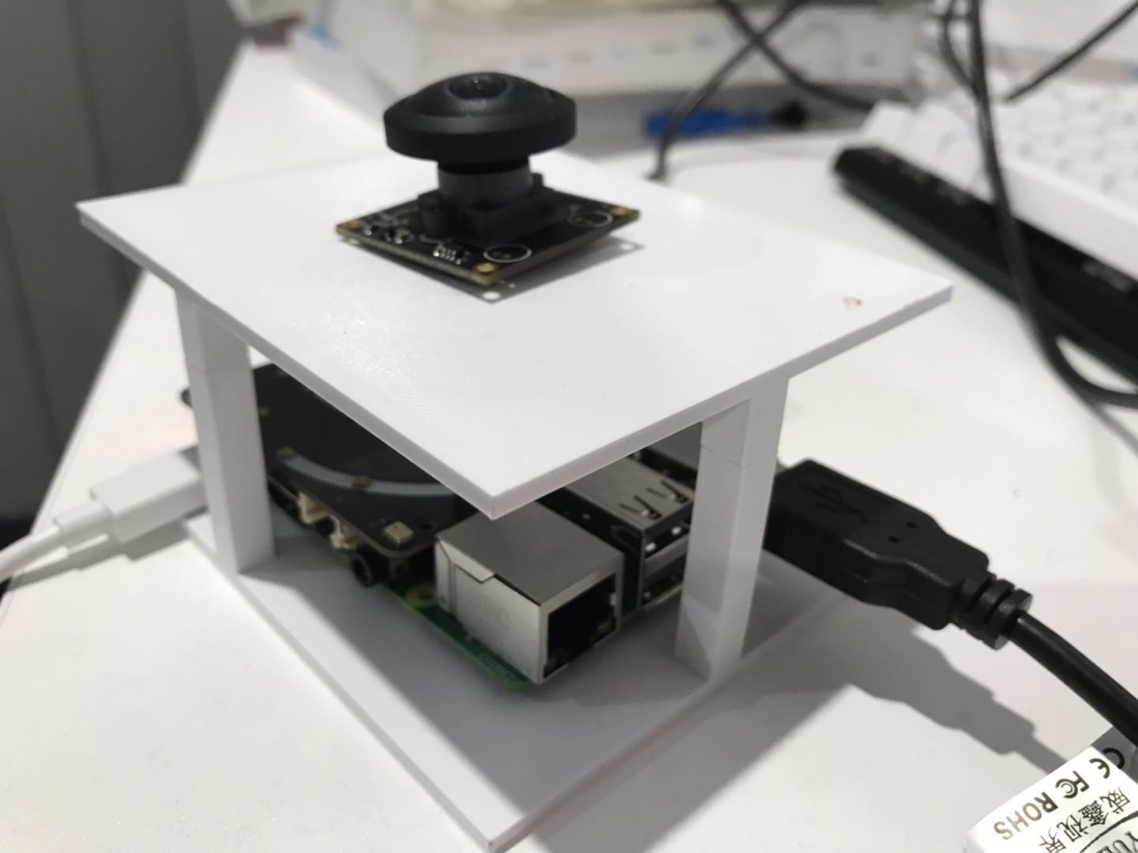

Slide 3
Objectives and Realisation
Objectives |  | Realisation
Audio | Clear sound input | Use external microphone for clear sound collection
 | Noise cancellation | Filtering for minimize noise
 | Sound localization | Use DOA algorithm on 4-mic sound arrays
Video | Fish eye view | Use 1080p Fisheye Camera
 | Face Detection | Use Rotation-invariant Face Detector / OpenCV built-in Cascade face detector
 | De-warping | Achieve live de-warping
I/O conversion | Camera to Ras-pi | Through OpenCV (but limited public resource)
 | Ras-pi (images) to PC | Upload process image to Ip address Recognize the IP stream as webcam input
 | Video to skype | Through a virtual device
Assemble |  | Design and 3D print modular frame

Slide 4
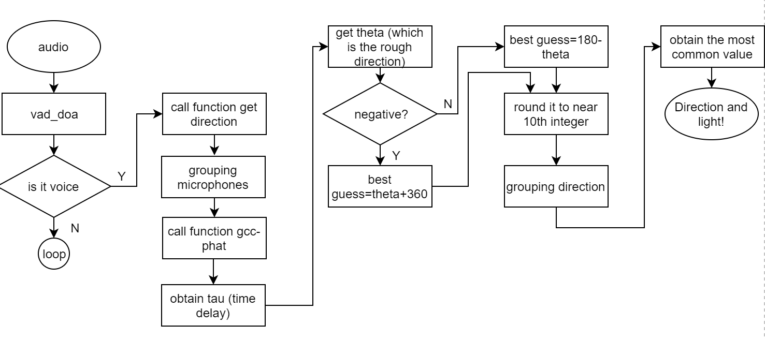
Audio System

Slide 5
- Download required drivers
Enable SPI pins.
- Verify that array hat is working by typing “arecord -L” in the terminal.
- Enable the pixel ring
- Install useful python packaged (numpy,pyaudio, webrtcvad.vad))

Slide 7
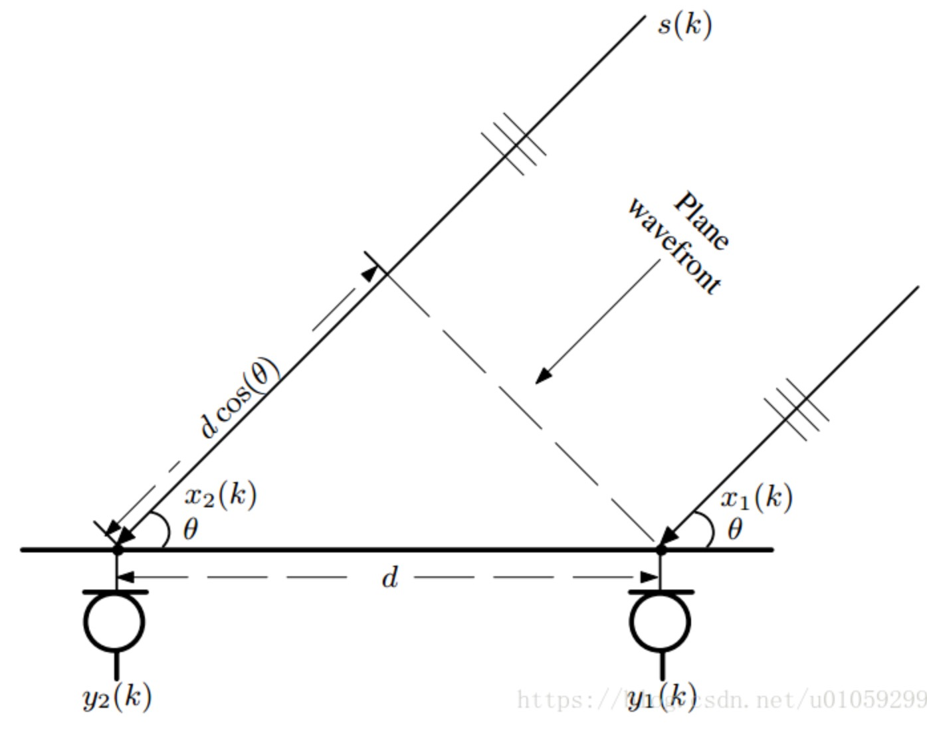
Gcc_phat.py
- This function can calculate the generalized cross correlation of different signals, one input is the real-time input and the other is reference signal.
- Obtain two signals from two different channels of mic array.
- Compute the time diffference of
two signals
- Compare time difference
with max_tau
- Calculate Theta (rough direction)

Slide 9
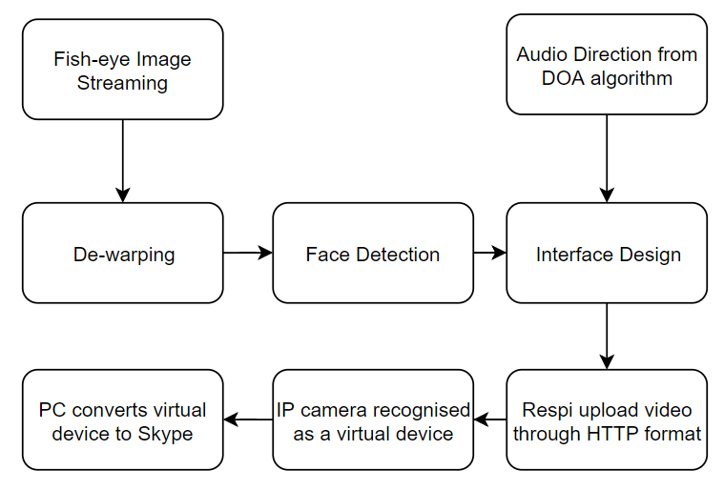
Ideal Completed Video System

Slide 10
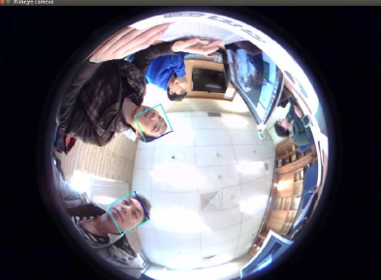
Initial Video Input

Slide 11
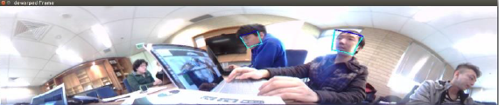
Fisheye De-warping

Slide 12
Face Detection
Built-in Cascade face detector from OpenCV: real-time and low computational requirement, but not rotation-invariant.
Rotation-invariant face detector using Progressive Calibration Networks (PCN). Real-time but high computational-requirement

Slide 13
IP Camera
The IP camera standard requires a large amount of low-level programing, but we have limited time frame.
There is nearly no open-source code to stream an OpenCV video as IP camera
Skype can only detect a normal webcam

Slide 14
Value Proposition
There is no existing innovation for Raspberry Pi to work as a web-cam Open source and highly accessible Inexpensive and easy to replicate Live face detection
Innovation
Producing a proof of concept prototype for an open source 360 degrees web conferencing device The use of rotationally invariance face detection with a fish-eye camera, using PCN face detection.

Slide 15
Challenges and Solutions
1) Multi-camera to Fisheye:
a. Raspberry Pi cannot support multiple cameras to cover a 360 degree view;
b. Budget
2) Fisheye de-warping. No existing open-source material, we wrote our own algorithm for de-warping.
3) Face Detection difficulty on Fish eye image: we adopted rotation-invariant face detector (PCN)
4) Video from Raspberry Pi has to meet UVC standard to be recognised by PC. It requires low-level programming. Thus, we upload video stream to a IP address.
5) Receiver or Skype cannot recognise the Video stream from IP address. There is no open-source solution yet. We are trying to work it out at this moment.

Slide 16
Handover
Source code of our system already at Git
We are drafting up a handover document that covers:
- intro
- Assembly – what components are needed: model, price and serial-number
- software: Video/ Audio/ I/O with comments
- FAQ (potential errors and troubleshooting)
3. A record of team’s progress and failures (team reflection).

